Slide 1
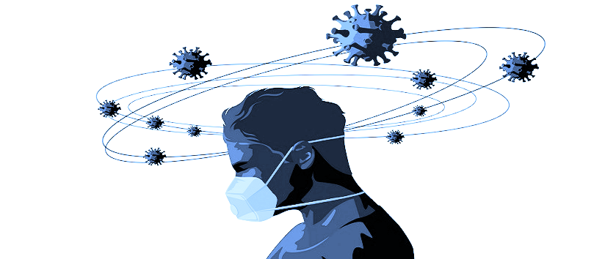
Covid-19 and Current Mental Health Correlation
Team: E-Z Coders
Daniel, Darren, Dwayne, Jessica, and Uzma

Slide 2

A supervised machine learning model that uses regression analysis to detect a correlation between COVID-19 cases and mental health issues such as depression across the United States of America to suggest ideal geographical locations for mental health clinics and relaxation centers.
Overview

Slide 3
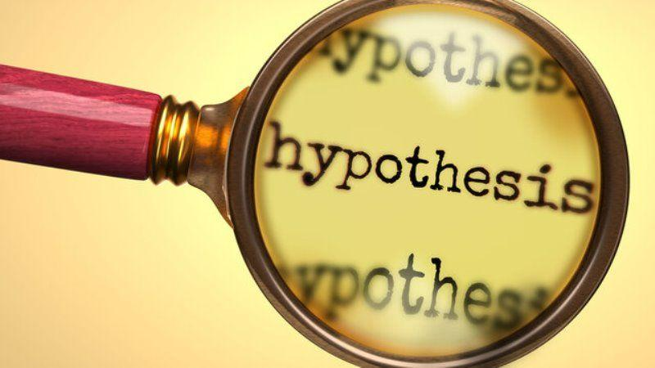
Hypothesis
Null Hypothesis
There is no relation between the COVID-19 pandemic and an increase in recent depression cases
Alternative Hypothesis
There is a relation between the COVID-19 pandemic and an increase in recent depression cases

Slide 4

Questions
1
What impact did covid have on mental health especially depression?
2
Was every state affected the same way or were some states affected more than others?
How accurately will the ML model predict an ideal state for mental wellness centers?
3

Slide 5











Python 3.7

